Slide 1
Bias Variance
Maram Al, Nouf Al, Nourah Alsaadan

Slide 2
AGENDA
Introduction
Errors
Bias
Variance
Bias Variance Trade-off
Total error
Error from Bias
Error from Variance
How does Bias and Variance affect the model ?
Total Error
Optimal balance
Bias-Variance Trade-Off Applications
Bias-Variance Trade-Off Applications KNN

Slide 3
Introduction
A machine learning model’s performance is evaluated based on how accurate is
its prediction and how well it generalizes on another independent dataset it has not seen.

Slide 4
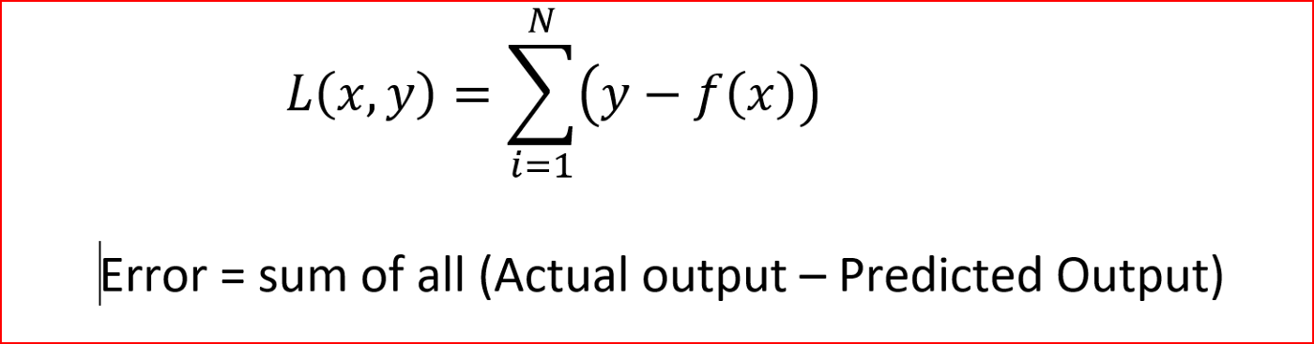
Errors
The errors in a machine learning model can be broken down into 2
Irreducable error
Errors that cannot be reduced no matter what algorithm you apply
Reducable error
Has two components — bias and variance.

Slide 5
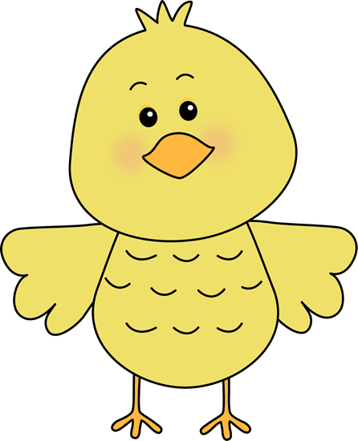
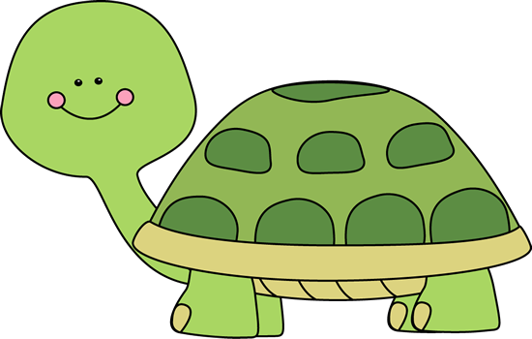
Bias
- Bias is basically how far we have predicted the values from actual values.

Slide 6
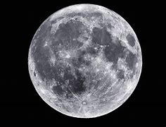
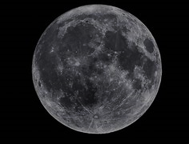
Variance
- Variance is basically how scattered the predicted values from actual values.

Slide 7
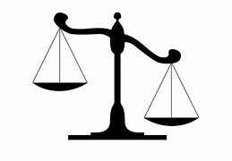
Bias Variance Trade-off
Variance
Bias
Models that have high bias tend to have low variance. For example, linear regression models tend to have high bias and low variance.
Models that have low bias tend to have high variance. For example, complex non-linear models tend to have low bias with high variance.
The bias-variance tradeoff refers to the tradeoff that takes place when we choose to lower bias which typically increases variance, or lower variance which typically increases bias.

Slide 8
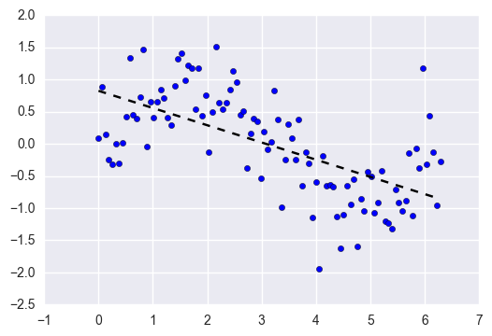
Error from Bias
fitting a linear regression to a dataset that has a non-linear pattern

Slide 9
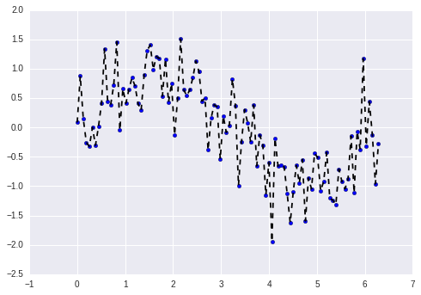
Error from Variance
Fitting a completely unconstrained, super-flexible model to the same dataset from above

Slide 10
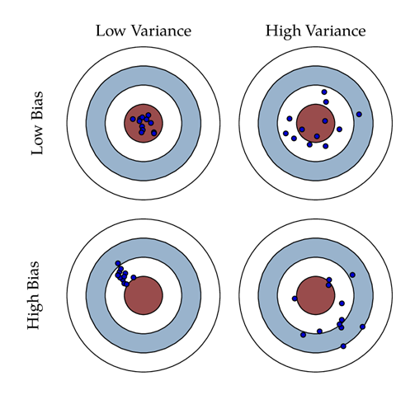
How does Bias and Variance affect the model ?
High Variance and High Bias: Model will be inconsistent and also inaccurate on average.
Low Variance and High Bias: Models are consistent but low on average.
(underfitting happens)
High Variance and Low Bias: Somewhat accurate but inconsistent on average. (overfitting happens)
Low Variance and Low Bias: It is the ideal one where the model is consistent and accurate on average.

Slide 11
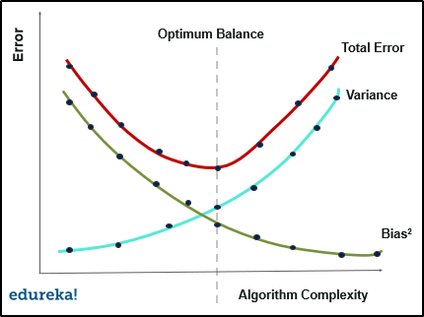
Total Error
- To build a good predictive model, you'll need to find a balance between bias and variance that minimizes the total error.
Total Error = Bias²+Variance+Irreducible error

Slide 12
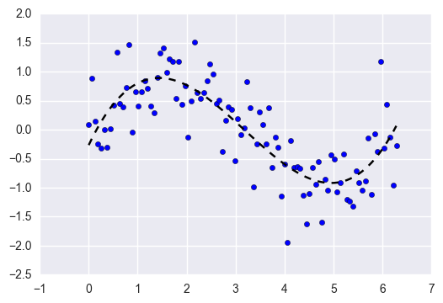
Total Error
isolate the signal from the dataset while ignoring the noise

Slide 13
Bias-Variance Trade-Off Applications
The goal of any supervised machine learning algorithm is to achieve low bias and low variance. In turn the algorithm should achieve good prediction performance.
Linear machine learning algorithms often have a high bias but a low variance.
Nonlinear machine learning algorithms often have a low bias but a high variance.
The parameterization of machine learning algorithms is often a battle to balance out bias and variance.

Slide 14
Bias-Variance Trade-Off Applications
Below are two examples of configuring the bias-variance trade-off for specific algorithms:
The k-nearest neighbors algorithm has low bias and high variance, but the trade-off can be changed by increasing the value of k which increases the number of neighbors that contribute t the prediction and in turn increases the bias of the model.
The support vector machine algorithm has low bias and high variance, but the trade-off can be changed by increasing the C parameter that influences the number of violations of the margin allowed in the training data which increases the bias but decreases the variance.

Slide 15
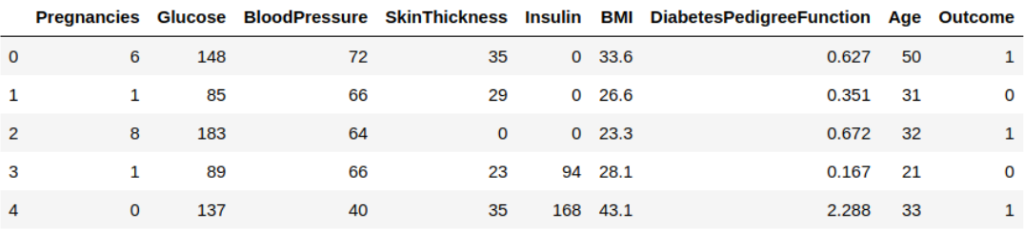

Bias-Variance Trade-Off Applications (KNN)
patient has diabetes or not
We need to predict the ‘Outcome’ column.
Let us separate it and assign it to a target variable ‘y’. The rest of the data frame will be the set of input variables X.

Slide 16
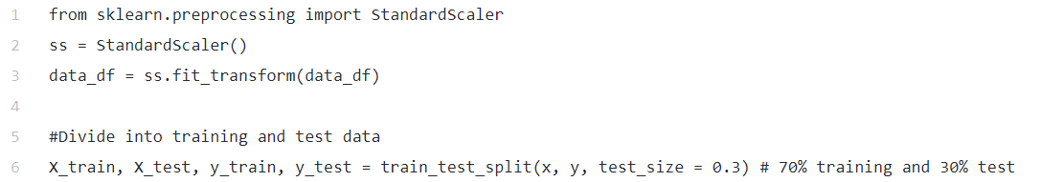
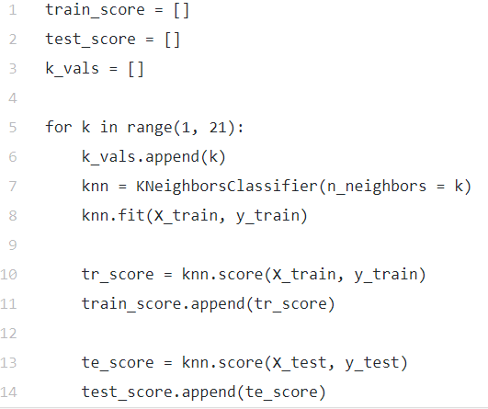
Bias-Variance Trade-Off Applications (KNN)
scale the predictor variables and then separate the training and the testing data.
Since the outcomes are classified in a binary form, we will use the simplest K-nearest neighbor classifier(Knn) to classify whether the patient has diabetes or not.
Take a few possible values of k and fit the model on the training data for all those values. We will also compute the training score and testing score for all those values.

Slide 17
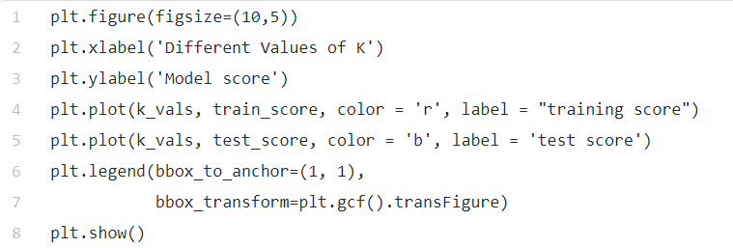
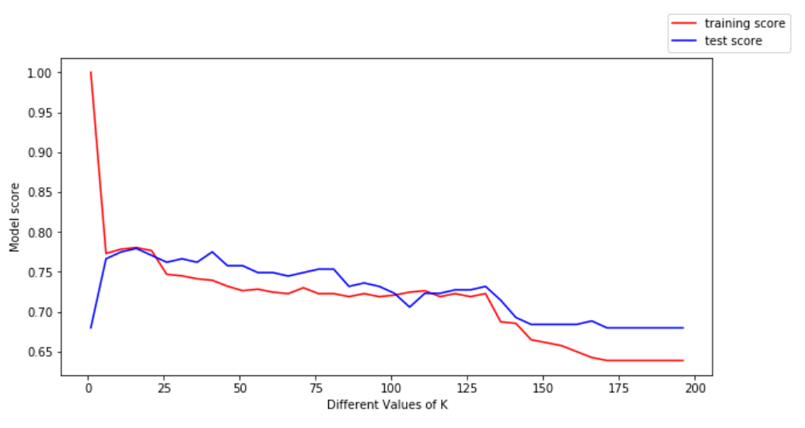
Bias-Variance Trade-Off Applications (KNN)
We can make the following conclusions from the above plot:
For low values of k, the training score is high, while the testing score is low
As the value of k increases, the testing score starts to increase and the training score starts to decrease.
However, at some value of k, both the training score and the testing score are close to each other.

